Slide 1
Internet Issues
Chapter 15
CS449-Professional Issues in Information Technology
Course Instructor: Engr. Saeeda Kanwal

Slide 2
Chapter Outcome
After reading this chapter, you should understand:
the reasons why misuse of the internet gives cause for concern;
the scope and limitations of the legislation that governs the use of the internet at present;
why it is difficult to enact legislation that will effectively regulate the use of the internet.

Slide 3
The Internet
The benefits that the internet has brought are almost universally recognized.
The access to all sorts of information is much easier
It has made communications between people much cheaper and convenient
Many types of commercial transactions are simplified and faster due to the internet
And, most importantly, these benefits have been made available to very many people, not just to a small and privileged group

Slide 4
The Internet…..
Inevitably, a development on this scale creates its own problems like:
Illegal or inappropriate materials
Addiction to online social networks
Spread of Spam or Viruses
These are topics that cannot sensibly be discussed in technical terms alone. There are social, cultural and legal issues that must all be considered. Different countries approach these issues in very different ways but the internet itself knows no boundaries.

Slide 5
The Internet…..
Some of the common Internet related issues:
>Lack Of Face To Face Communication
>Lack Of Creativity > Insomnia
>Cyber Bullying > Physical Inactivity
>Waste Of Time > Internet Addiction
>Abandonment Of Family > Cheating
>Privacy Disrupted > Moral Corruption

Slide 6
The Internet…..
Every country has laws governing what can be published or publicly displayed
Typically, such laws address defamation, that is, material that makes unwelcome allegations about people or organizations
They may also cover other areas such as political and religious comments, incitement to racial hatred, or the depiction of violence

Slide 7
The Internet…..
Although every country has such laws, they are very different from each other
In some countries, publication of material criticizing the government or the established religion is effectively forbidden
While in others it is a right guaranteed by the constitution and vigorously defended by the courts

Slide 8
The Internet…..
The coming of the internet (and satellite television) has made these differences much more apparent and much more important than they used to be
Since material flows across borders so easily, it is both much likelier that material that violates publication laws will come into a country and more difficult for the country to enforce its own laws
The roles and responsibilities of ISPs are a central element in the way these issues are addressed

Slide 9
Internet service providers
The central issue we need to consider is how far an Internet Service Provider can be held responsible for material generated by its customers
In Europe, the position is governed by the European Directive 2000/31/EC. In the UK this directive is implemented through the Electronic Commerce (EC
Directive) Regulations 2002
These regulations follow the EC Directive in emphasizing three roles that an ISP may play: mere conduit, caching, and hosting

Slide 10
Internet service providers
The role of mere conduit is that in which the ISP does no more than transmit data; in particular, the ISP does not:
initiate transmissions
select the receivers of the transmissions
select or modify the data transmitted
It is compatible with the role of mere conduit for an ISP to store information temporarily, provided this is only done as part of the transmission process
In case an ISP is acting as a mere conduit, the regulations won’t hold it liable for damages or for any other criminal sanction as a result of a transmission

Slide 11
Internet service providers….
The caching role arises when the information is the subject of
automatic
intermediate and
temporary storage
for the sole purpose of increasing the efficiency of the transmission of the information to other recipients of the service upon their request
An ISP acting in the caching role is not liable for damages or for any criminal sanction as a result of a transmission, provided that it:

Slide 12
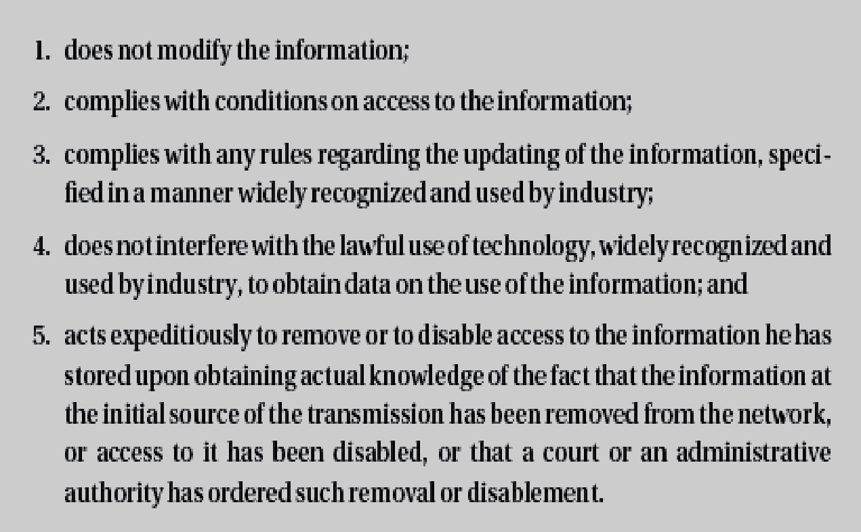
Internet service providers….

Slide 13
Internet service providers….
Where an ISP stores customer information, it is acting in a hosting role. In this case, it is not liable for damage or criminal sanctions provided that:
a)It did not know that anything unlawful was going on
b)Where a claim for damages is made, the ISP did not know anything that will lead to something unlawful
c)When it found out that that something unlawful was going on, it immediately tried to remove the info or prevented access to it, and
d)The customer was not acting under the authority or the control of the service provider

Slide 14
Internet service providers….
In the UK, the ISP is allowed to release the information and can be compelled to do so by a court
In the USA, ISPs cannot in general be required to release the information, although they may be required to do so in the case of serious crimes

Slide 15
Law across National Boundaries
Criminal Law: Suppose that you live in country A and on your website you publish material that is perfectly legal & acceptable in country A, but it is a criminal offence to publish in country B
In that case you can’t be prosecuted in country A and it is very unlikely that you would be extradited to country B
To avoid getting into trouble, you might however, be careful in not visiting country B voluntarily

Slide 16
Law across National Boundaries
Civil law: There are some parts of the civil law where the position is reasonably clear cut
Any contract that involves parties from more than one country should, and usually will, state explicitly under which jurisdiction (that is, which country’s laws) it is to be interpreted
Where intellectual property law is concerned, there are international agreements to which most countries are signatories so that there is a common framework, though it can be very difficult to enforce the rights in certain countries

Slide 17
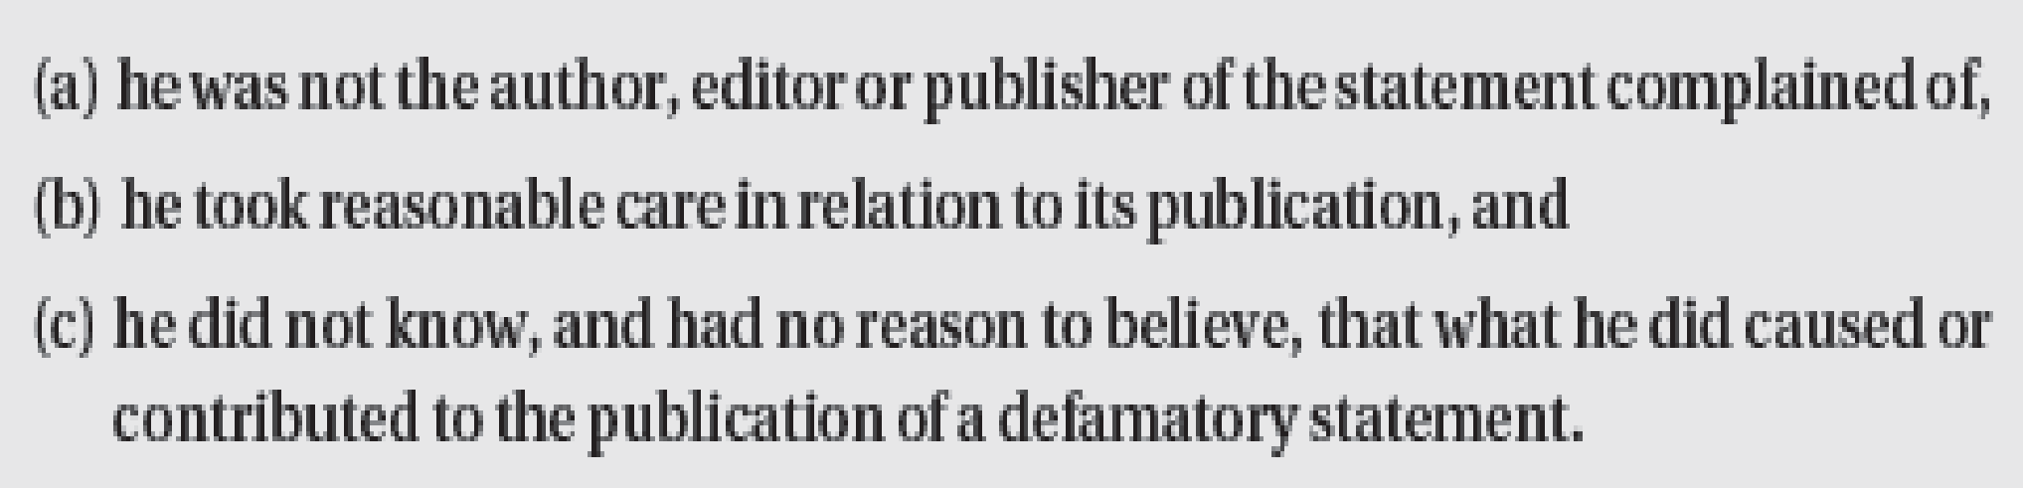
Defamation
Defamation means making statements that will damage someone’s reputation, bring them into contempt, make them disliked, and so on
In British law, spoken offence is called slander and written is called libel.(It could be email)
The defendant needs to prove that:

Slide 18
Defamation…..
If any objectionable material is published on, for example, newspaper, website etc. the complainant can take action against the publisher of the newspaper, and the editor etc.
Question: What if something objectionable is posted on a forum of a university?

Slide 19
Defamation…..
When the libel is published on a web page, on the university site, the university can reasonably argue that it cannot possibly vet everything that every one of its 1,000 students puts on their personal web page.
It is not, in fact, publishing the pages, it is only providing an infrastructure that allows students to publish their own web pages. In the terminology used in the 2002 Regulations it is acting in a hosting role.
Provided, therefore, that it removed the offending material as soon as it had reason to suspect its presence and that the student was not acting under its authority or control, the university cannot be subject to an action for damages.

Slide 20
Defamation…..
The First Amendment to the United States Constitution guarantees a right to free speech that the US courts have always been eager to defend.
The result is that many statements that might be considered defamatory in the UK would be protected as an exercise of the right of free speech in the USA.

Slide 21
Organization for Cybercrime
The International Convention on Cybercrime:
In 2001, the Council of Europe approved a draft convention on ‘cybercrime’.
It deals with objectionable material on the internet, criminal copyright infringement, computer-related fraud and hacking.
There is an additional protocol relating to incitement to religious or racial hatred, to which signatories to the protocol may also sign up.

Slide 22
Organization for Cybercrime…
Internet Watch Foundation:
In the UK, the Internet Watch Foundation (IWF) was set up in 1996 to monitor and, where desirable and possible, take action against illegal and offensive content on the UK internet.
It has the support of the UK government, the police and the ISPs.

Slide 23
Organization for Cybercrime…
The Internet Content Rating Association:
The Internet Content Rating Association (ICRA) is an international, independent organization whose mission, it claims, is: ‘to help parents to protect their children from potentially harmful material on the internet, whilst respecting the content providers’ freedom of expression.’
Its board includes representatives from the major players in the internet and communications markets, including AOL, BT, Cable and Wireless, IBM, Microsoft and Novell.

Slide 24
Spam
‘Unsolicited email sent without the consent of the addressee and without any attempt at targeting recipients who are likely to be interested in its contents’.

Slide 25
Spam….
In the UK, the directive was implemented by the Privacy and Electronic Communications (EC Directive) Regulations 2003.
Unsolicited email can only be sent to individuals (as opposed to companies) if they have previously given their consent.
Sending unsolicited email that conceals the address of the sender or does not provide a valid address to which the recipient can send a request for such mailings to cease is unlawful.

Slide 26
Spam….
If an email address has been obtained in the course of the sale of goods or services, the seller may use the address for direct mailings, provided that the recipient is given the opportunity, easily and free of charge, with every message, to request that such mailings cease.

Slide 27
Spam….
In the USA it is the responsibility of the recipient to inform the spammer that he doesn’t want to receive the spam. It is legal to send spam if:
The person sending the spam has not been informed by the receiver that they do not wish to receive spam from that source.
The spam contains an address that the receiver can use to ask that no more spam be sent.

Slide 28
Registration of Phone numbers
Both the USA and the UK operate successful schemes that allow individuals to register their phone numbers as ones to which unsolicited direct marketing calls must not be made.
This should act as a model for preventing spam; indeed, the CAN SPAM Act specifically requires the Federal Trade Commission to produce plans for such a register within six months.
Unfortunately, the technical differences between the internet and the telephone network makes this model unlikely to work with spam.

Slide 29
Registration….
In most cases, use of the internet is not charged on the basis of individual communications but on the basis of connect time, so there is no recording of individual emails and it costs the same to send an email from Australia to the UK than it does to send an email to one’s colleague in the next office.

Slide 30
Registration…
Furthermore, spamming is easy due to forging the sender’s address on an email, and also using other people’s mail servers to send you mail.
Due to this fact there are no reliable records that can be used to identify where the spam really came from or to stop it completely.

Slide 31
Further reading
www.lawcom.gov.uk/files/defamation2.pdf
www.cyber-rights.org/reports/governan.htm
www.cultsock.ndirect.co.uk/MUHome/cshtml/index.html
www.iwf.org.uk
www.icra.org

